Slide 1
Machine Learning DASC 522
Decision Support & DoD Machine Learning
Dr. Torrey Wagner

Slide 2
Overview
Decision Support Motivation
2019 Executive Order
2018 DoD AI Strategy
USAF Annex to DoD AI Strategy
2019 Defense Innovation Board Report
AI – Using Standards to Mitigate Risks
Senior DoD AI Personnel

Slide 3
Overview
Decision Support Motivation
2019 Executive Order
2018 DoD AI Strategy
USAF Annex to DoD AI Strategy
2019 Defense Innovation Board Report
AI – Using Standards to Mitigate Risks
Senior DoD AI Personnel

Slide 4
Motivation for a Data-to-Decision Workflow
Goal is to make better decisions
Many ways to make decisions
Heuristic-based Human Judgement
Data Analysis (correlation, trends)
Human-built computational models (e.g. expert systems)
Machine Learning suggests learning from Data
But where does the data come from?
And what resulting decision activities will the data support?
How does this fit into a process?
Slide from Dr. Brett Borghetti, AFIT/ENG CSCE 623 Statistical Machine Learning course, 2019SP

Slide 5
Where does ML fit in a workflow?
ML can help:
Determine what objects an image contains
Decide which category an observation in the data belongs to
Predict a value of a variable based on other observed values
A workflow is a defined sequence of steps used to process something / do something / answer a question
Where does ML fit?
Before ML can occur, data* is gathered, wrangled, cleaned…
After ML gives an output, decisions are made
*Data can be numbers, text, audio, images, video….
Slide from Dr. Brett Borghetti, AFIT/ENG CSCE 623 Statistical Machine Learning course, 2019SP

Slide 6
Workflow Motivation
Since decisions derived from Data are only as good as the data, we must ensure the data collection, management, and analysis process is sound
CRISP-DM
Slide from Dr. Brett Borghetti, AFIT/ENG CSCE 623 Statistical Machine Learning course, 2019SP

Slide 7
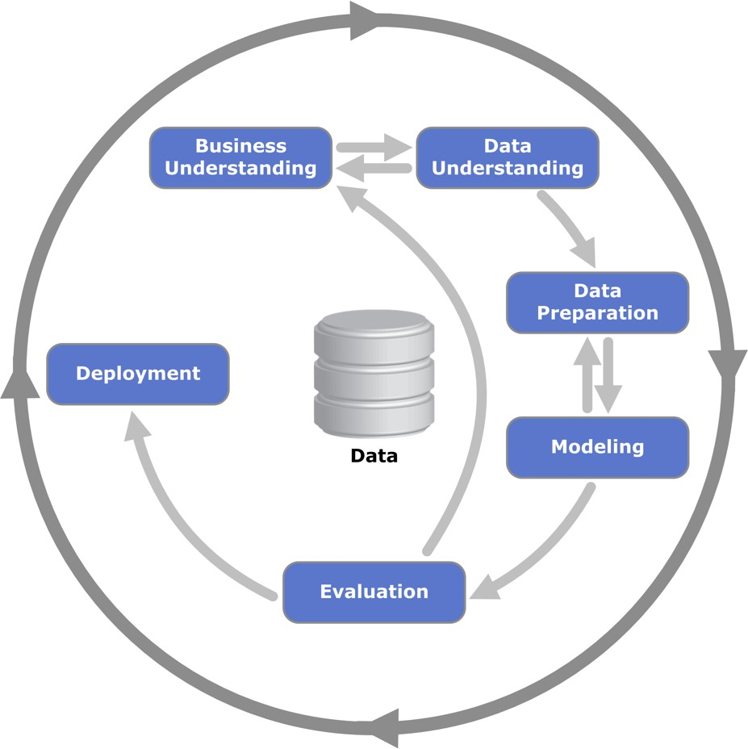
Cross Industry Standard Process for Data Mining (CRISP-DM)
Business understanding | Data understanding | Data Prep | Modeling | Evaluation | Deployment
Determine business objectives | Collect initial data | Select data | Select modeling techniques | Evaluate results | Plan deployment
Assess situation | Describe data | Clean data | Generate test design | Review Process | Plan monitoring & maintenance
Determine DM objectives | Explore data | Construct data | Build model | Determine next steps | Produce final report
Produce project plan | Verify data quality | Integrate data | Assess model |  | Review project
 |  | Format data
Process diagram showing the relationship between the different phases of CRISP-DM
https://en.wikipedia.org/wiki/Cross_Industry_Standard_Process_for_Data_Mining#/media/File:CRISP-DM_Process_Diagram.png
CC-SA Kenneth Jansen
Ó. Marbán et al., “A Data Mining & Knowledge Discovery Process Model,” in Data Mining and Knowledge Discovery in Real Life Applications, no. February, J. Ponce and A. Karahoca, Eds. Vienna, Austria: I-Tech, 2009, pp. 483–453.
Slide from Dr. Brett Borghetti, AFIT/ENG CSCE 623 Statistical Machine Learning course, 2019SP

Slide 8
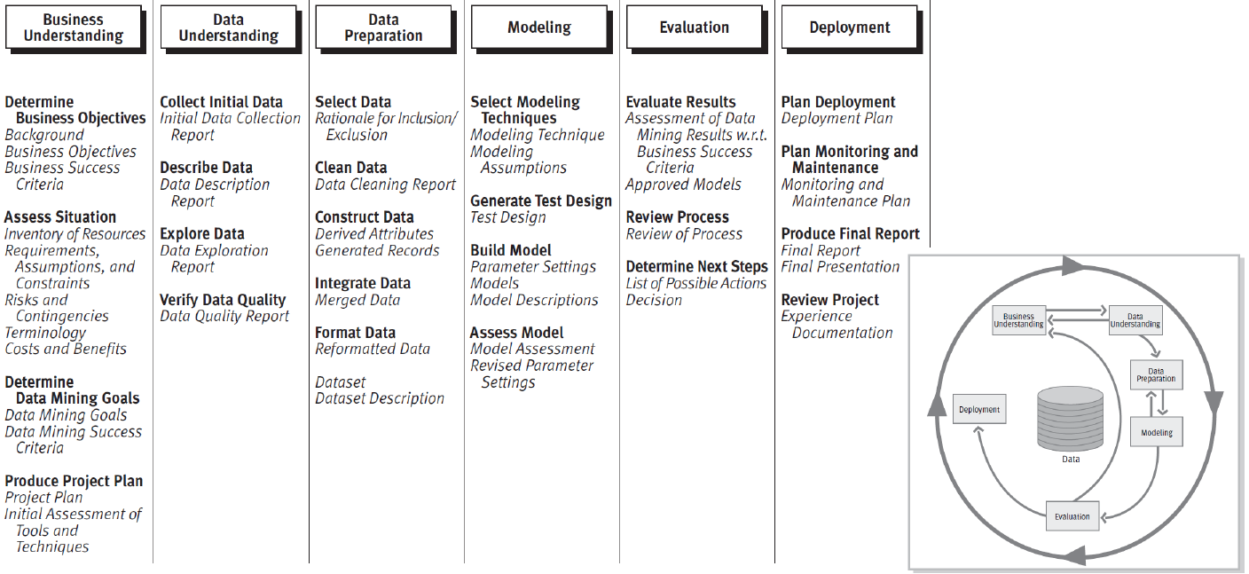
Cross Industry Standard Process for Data Mining (CRISP-DM)

Slide 9
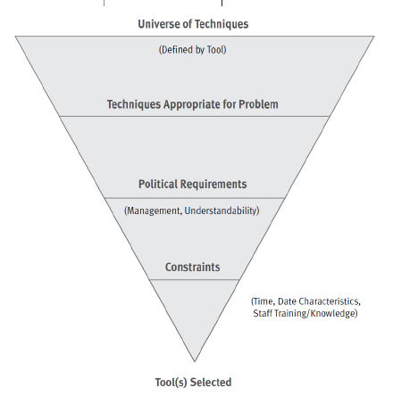
Cross Industry Standard Process for Data Mining (CRISP-DM)

Slide 10
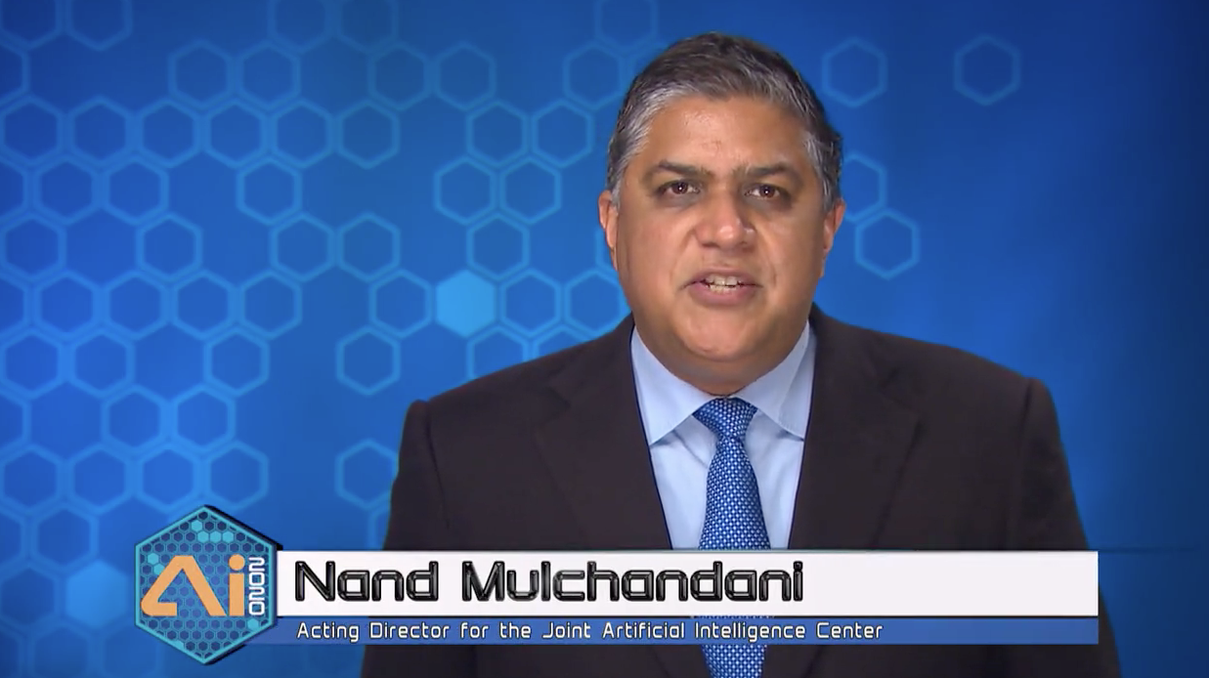
JAIC Director Video

Slide 11
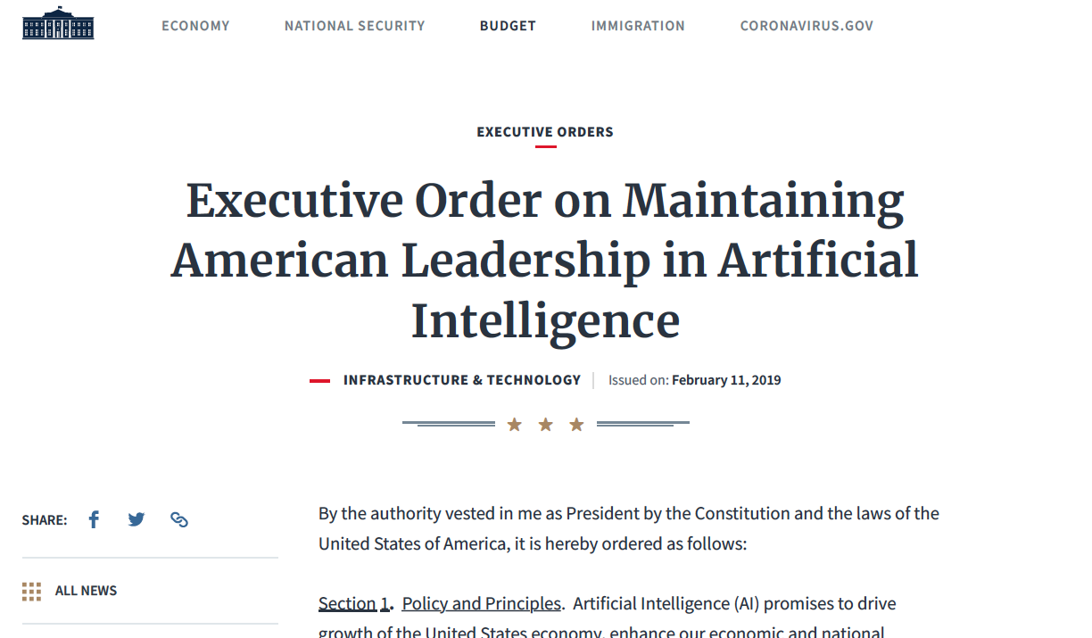
Overview
2019 Executive Order
2018 DoD AI Strategy
USAF Annex to DoD AI Strategy
2019 Defense Innovation Board Report
AI – Using Standards to Mitigate Risks
Senior DoD AI Personnel

Slide 12
2019 Executive Order
5 Principles of the American AI Initiative
The US must drive technological breakthroughs in AI … to promote scientific discovery, economic competitiveness, and national security.
The US must drive development of appropriate technical standards … in order to enable the creation of new AI-related industries and the adoption of AI by today’s industries.
The US must train current and future generations of American workers with the skills to develop and apply AI technologies to prepare them for today’s economy and jobs of the future.
The US must foster public trust and confidence in AI technologies and protect civil liberties, privacy, and American values in their application in order to fully realize the potential of AI technologies for the American people.
The US must promote an international environment that supports American AI research and innovation and opens markets for American AI industries;
while protecting our technological advantage in AI and
protecting our critical AI technologies from acquisition by strategic competitors and adversarial nations.

Slide 13
2019 Executive Order
6 Strategic Objectives
Promote sustained investment in AI R&D in collaboration with (numerous)… rapidly transition those breakthroughs into capabilities that contribute to our economic and national security.
Enhance access to high-quality and fully traceable Federal data, models, and computing resources … while maintaining safety, security, privacy, and confidentiality protections.
Reduce barriers to the use of AI technologies … while protecting American technology, economic and national security, civil liberties, privacy, and values.
Ensure that technical standards minimize vulnerability to attacks from malicious actors … and develop international standards to promote and protect those priorities.
Train the next generation of American AI researchers and users through apprenticeships; skills programs; and STEM education, with an emphasis on computer science ...
Develop and implement an action plan, in accordance with the National Security Presidential Memorandum “Protecting the United States Advantage in Artificial Intelligence and Related Critical Technologies”

Slide 14
2019 Executive Order
Coordinating Authority: National Science and Technology Council (NSTC) Select Committee on Artificial Intelligence
Heads of all agencies shall
review their Federal data and models to identify opportunities to increase access and use by the greater non-Federal AI research community
consider AI as a priority area within existing Federal fellowship and service programs
The Secretaries of Defense, Commerce, Health and Human Services, and Energy, NASA & NSF shall prioritize the allocation of high-performance computing resources for AI-related applications

Slide 15
2019 Executive Order
References
Cross-Agency Priority Goal: Leveraging Federal Data as a Strategic Asset
National Security Presidential Memorandum “Protecting the United States Advantage in Artificial Intelligence and Related Critical Technologies”

Slide 16
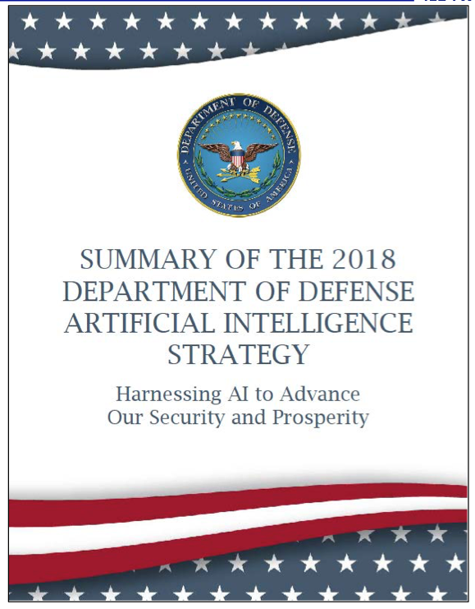
Overview
2019 Executive Order
2018 DoD AI Strategy
USAF Annex to DoD AI Strategy
2019 Defense Innovation Board Report
AI – Using Standards to Mitigate Risks
Senior DoD AI Personnel

Slide 17
National Security
2017 National Security Strategy pillars
Protecting the American People, the Homeland, and the American Way of Life;
Promoting American Prosperity;
Preserving Peace Through Strength and;
Advancing American Influence.
2018 National Defense Strategy objectives
defending the homeland;
dissuading, preventing, or deterring state adversaries and non-state actors from acquiring, proliferating, or using weapons of mass destruction; and
preventing terrorists from directing or supporting external operations against the United States homeland and our citizens, allies, and partners overseas.

Slide 18
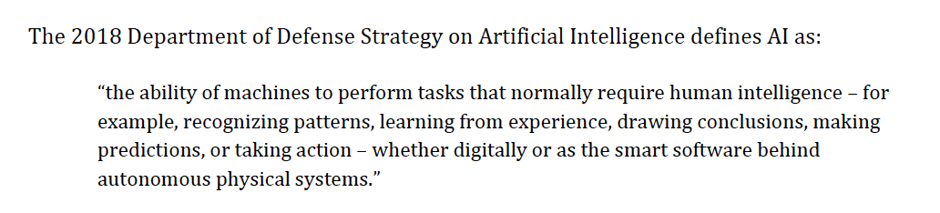
2018 DoD AI Strategy

Slide 19
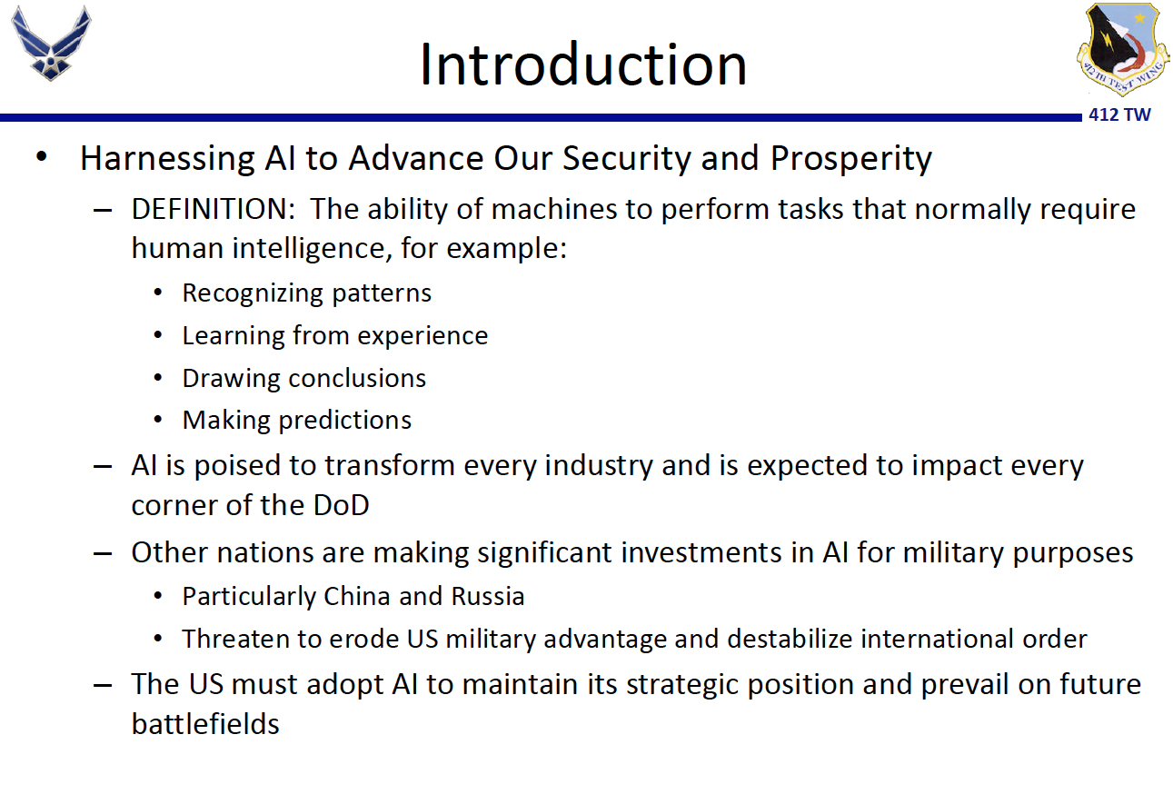

Slide 20
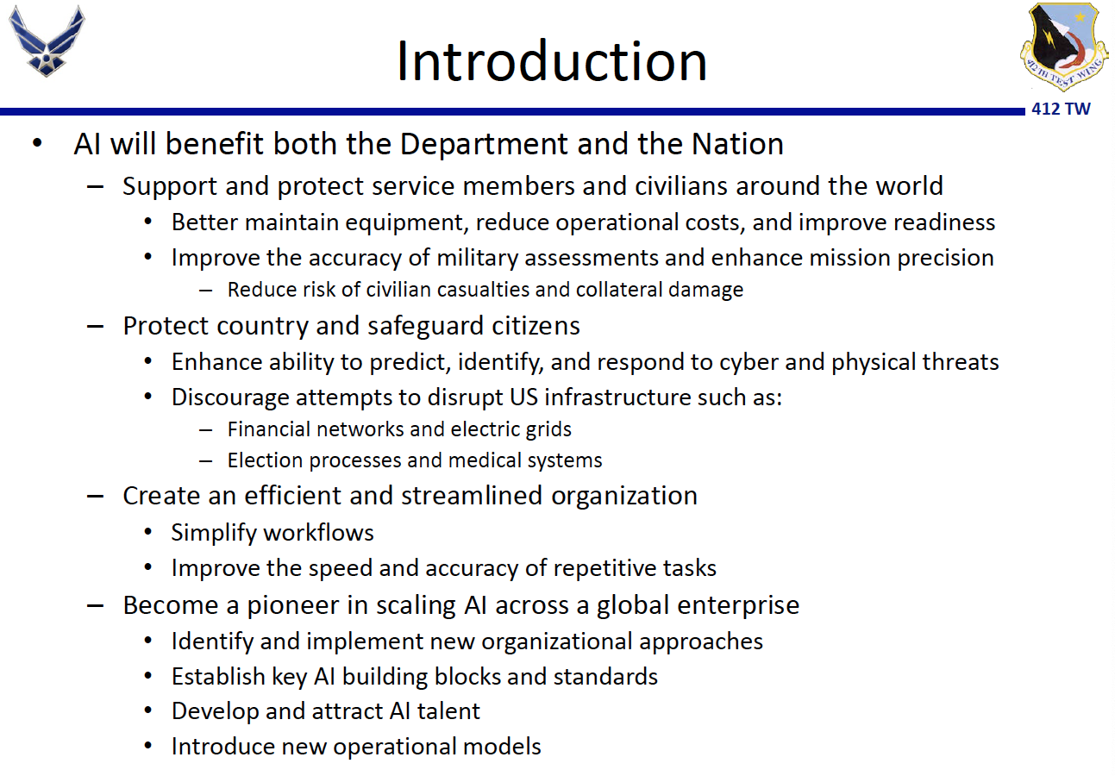

Slide 21
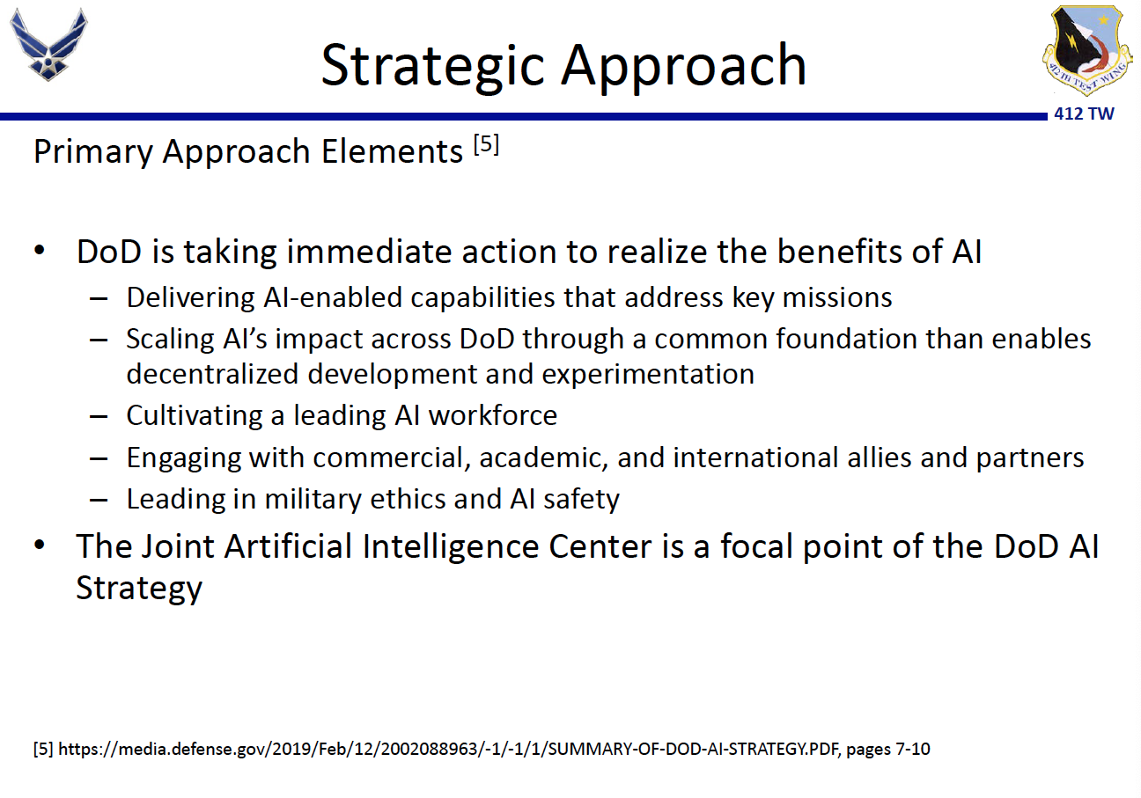

Slide 22
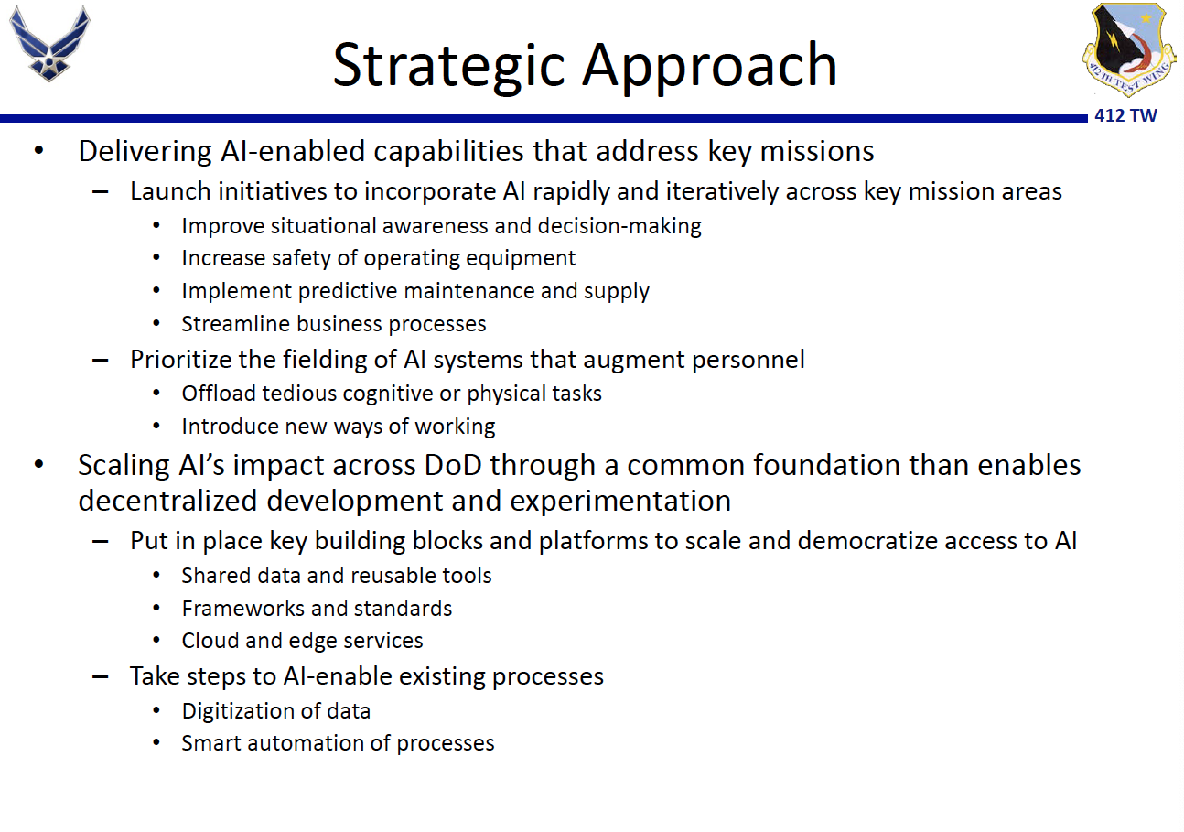

Slide 23
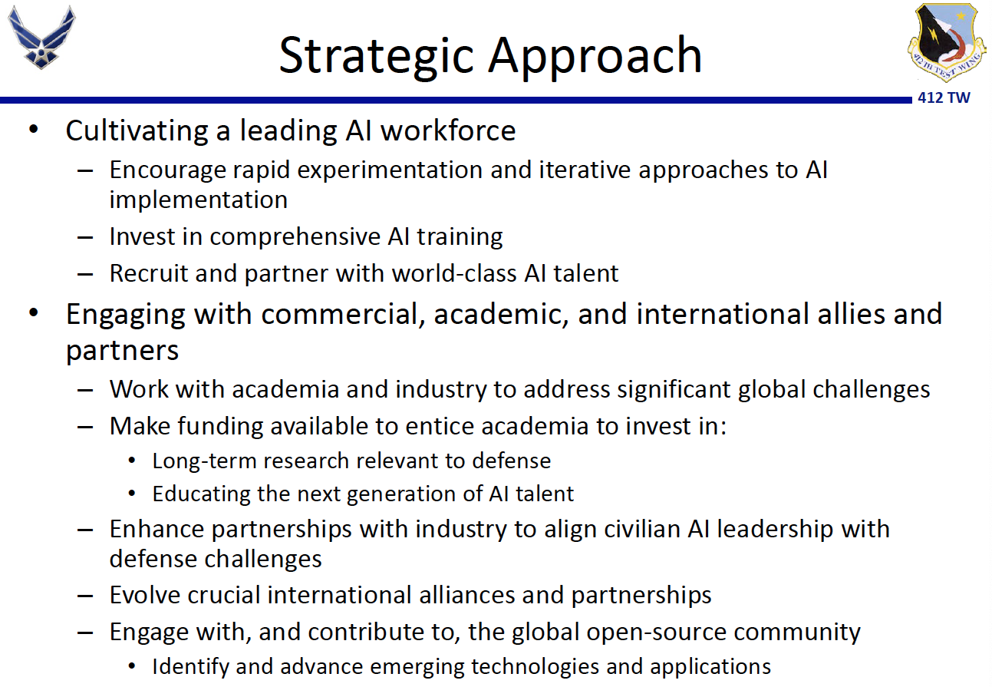

Slide 24
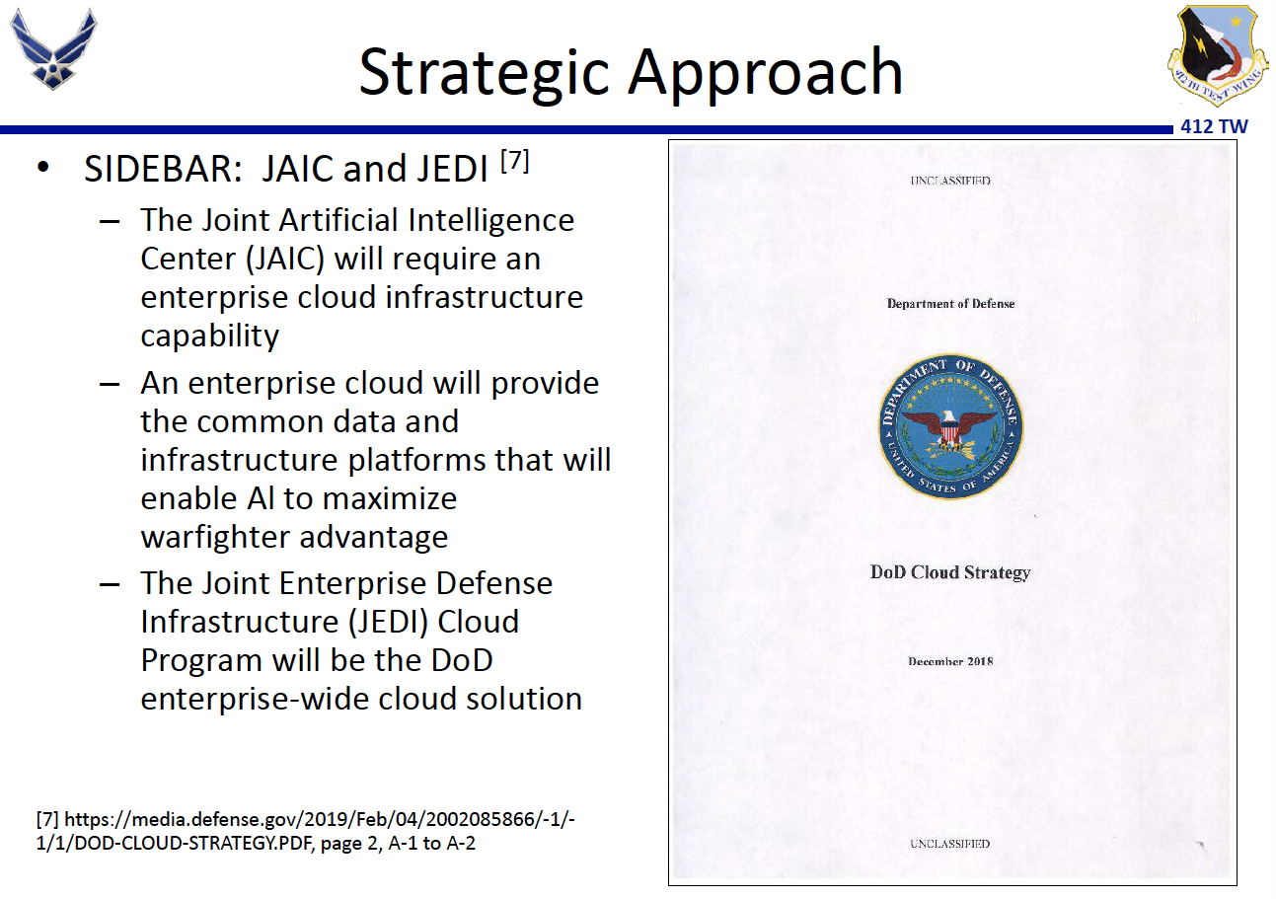

Slide 25
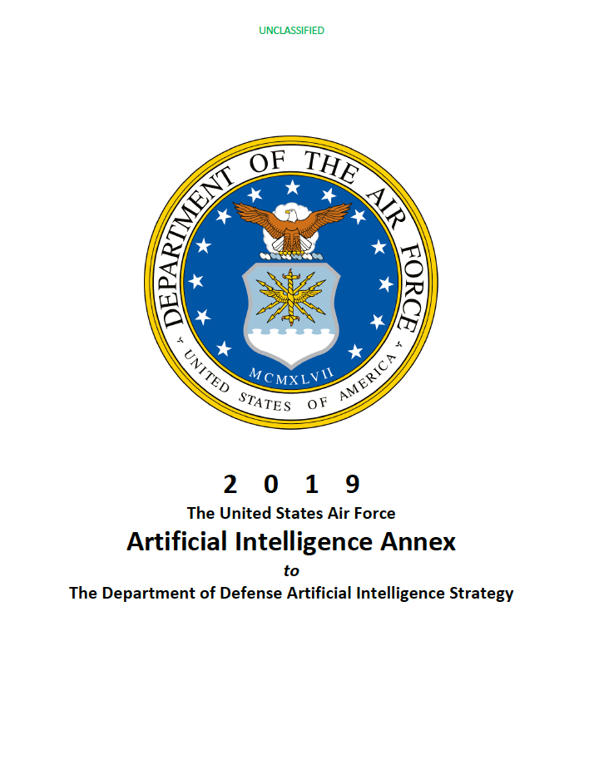
Overview
2019 Executive Order
2018 DoD AI Strategy
USAF Annex to DoD AI Strategy
2019 Defense Innovation Board Report
AI – Using Standards to Mitigate Risks
Senior DoD AI Personnel

Slide 26
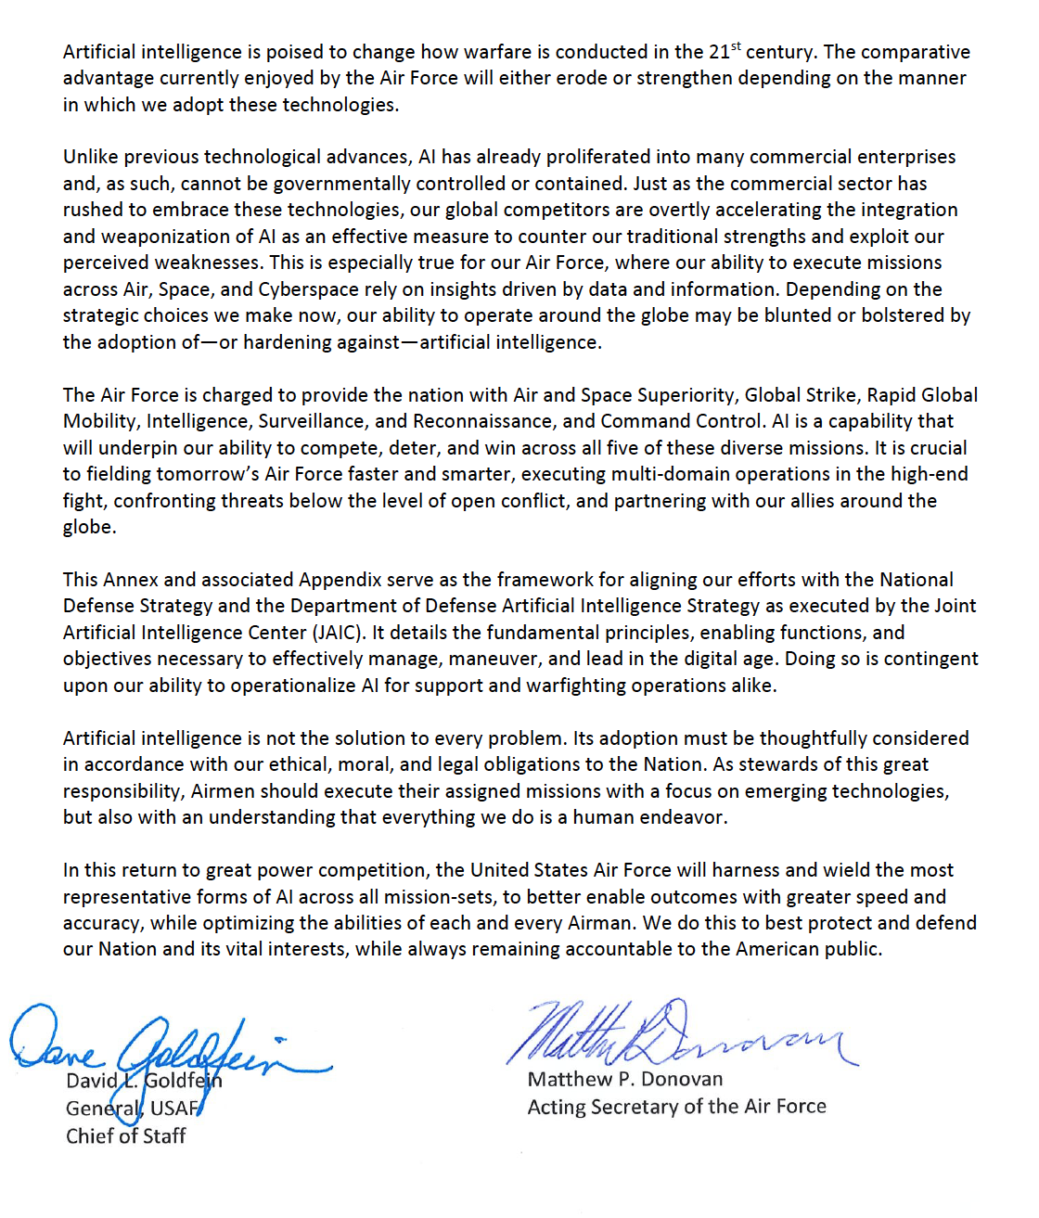
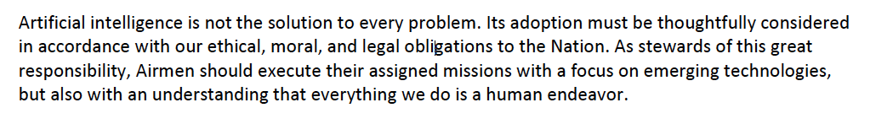
Excerpts

Slide 27
USAF Annex to DoD AI Strategy
5 Focus Areas
Drive down technological barriers to entry
Line of Effort 1: Operate on technology deployment models that fully exploit commercial capabilities (OPRs: AF/CIO, AF/AQ)
Objective 1.1: Employ a hybrid software-, platform-, and infrastructure-as-a-service model
Objective 1.2: Accept commercial standards and drive towards open standards in transition and procurement programs

Slide 28
USAF Annex to DoD AI Strategy
5 Focus Areas
Recognize and treat data as a strategic asset
Line of Effort 2: Continuously generate training-quality data and securely transport to proper hardware, software, and personnel (OPR: AF/CDO)
Objective 2.1: Set policy and standards for training-quality data
Objective 2.2: Identify, measure, build, and simulate support/operation authoritative data and information
Objective 2.3: Model, digitize, and instrument everyday business workflows
Objective 2.4: Create controlled and searchable data stores for massive training data accessible to anyone with appropriate credentials

Slide 29
USAF Annex to DoD AI Strategy
5 Focus Areas
Democratize access to artificial intelligence solutions
Line of Effort 3: Develop and field a diverse set of algorithms at risk-appropriate speed and scale (OPRs: AF/CIO, AF/AQ, AFRL)
Objective 3.1: Utilize free and publicly available algorithms
Objective 3.2: Host and provide shareable solutions enterprise-wide
Objective 3.3: Create secure operating environments for DevOps, prototyping algorithms, and ensure that outputs carry full provenance for appropriate use

Slide 30
USAF Annex to DoD AI Strategy
5 Focus Areas
Recruit, develop, upskill, and cultivate our workforce
Line of Effort 4: Develop people and employ a skilled, educated, and solution oriented workforce (OPR: AF/A1)
Objective 4.1: Develop a technologically well-versed workforce through the computer language initiative and provide multiple modalities for global access to coding/programming education
Objective 4.2: Ensure proper utilization and placement of a digitally talented workforce
Objective 4.3: Design practical policies and incentives that foster talent management and increase recruitment and retention
Objective 4.4: Partner with Joint, industry, and academic partners to foster cross-collaboration for training and tradecraft

Slide 31
USAF Annex to DoD AI Strategy
5 Focus Areas
Increase transparency and cooperation with international, government, industry, and academic partners
Line of Effort 5: Enhance public trust by leading dialogue on Air Force use of AI in ethical, moral, and legal uses (OPR: AF AI CFT, AFRL)
Objective 5.1: Engage in dialogue on the ethical, moral, and legal implications of employing AI in military operations in concert with the Joint AI Center

Slide 32
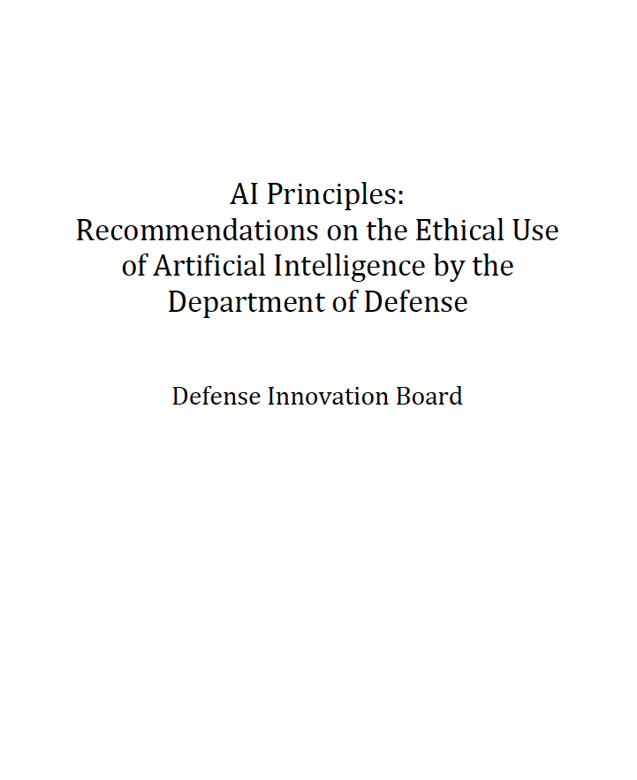
Overview
2019 Executive Order
2018 DoD AI Strategy
USAF Annex to DoD AI Strategy
2019 Defense Innovation Board Report
AI – Using Standards to Mitigate Risks
Senior DoD AI Personnel

Slide 33
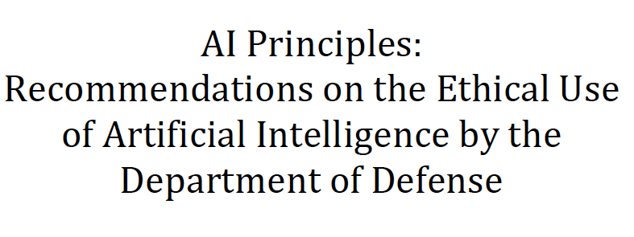
2019 Defense Innovation Board

Slide 34
2019 Defense Innovation Board
Develop strategy IAW
1949 Geneva Conventions
Customary international law
DoD Law of War Manual

Slide 35
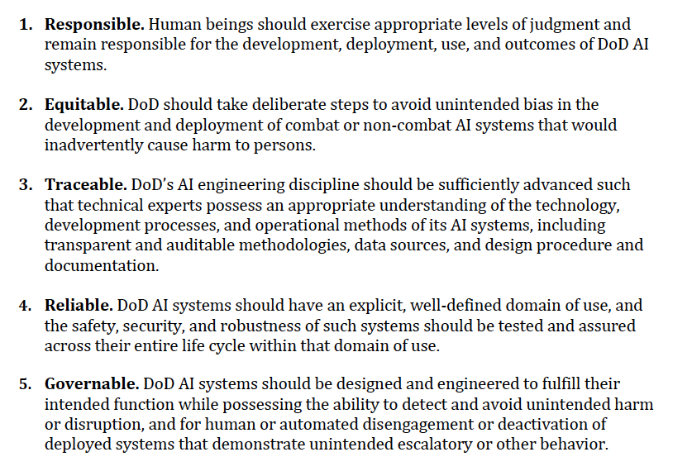
2019 Defense Innovation Board
The Department should set the goal that its use of AI systems is:

Slide 36
2019 Defense Innovation Board
Recommendations (1 of 2)
Formalize these principles via official DoD channels. The Joint AI Center should recommend to the Secretary of Defense the proper communications and policy issuances to ensure the lasting nature of these AI ethics principles.
Establish a DoD-wide AI Steering Committee
Cultivate and grow the field of AI engineering
Enhance DoD training and workforce programs.
Invest in research on novel security aspects of AI.
Invest in research to bolster reproducibility

Slide 37
2019 Defense Innovation Board
Recommendations (2 of 2)
Define reliability benchmarks.
Strengthen AI test and evaluation techniques.
Develop a risk management methodology
Ensure proper implementation of AI ethics principles
Expand research into understanding how to implement AI ethics principles
Convene an annual conference on AI safety, security, and robustness

Slide 38
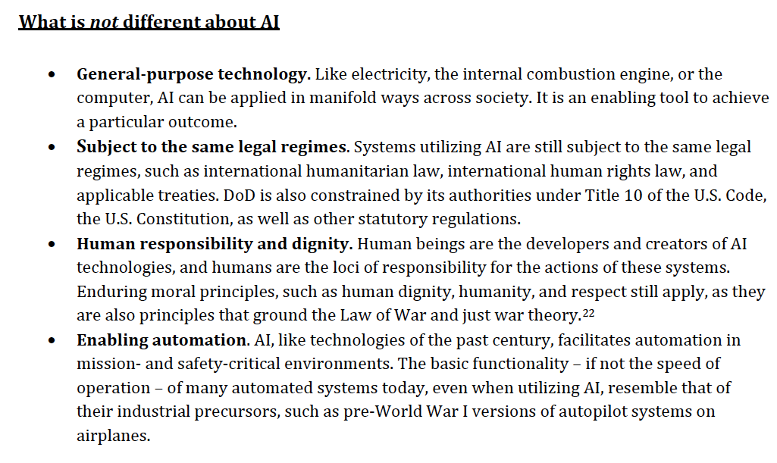
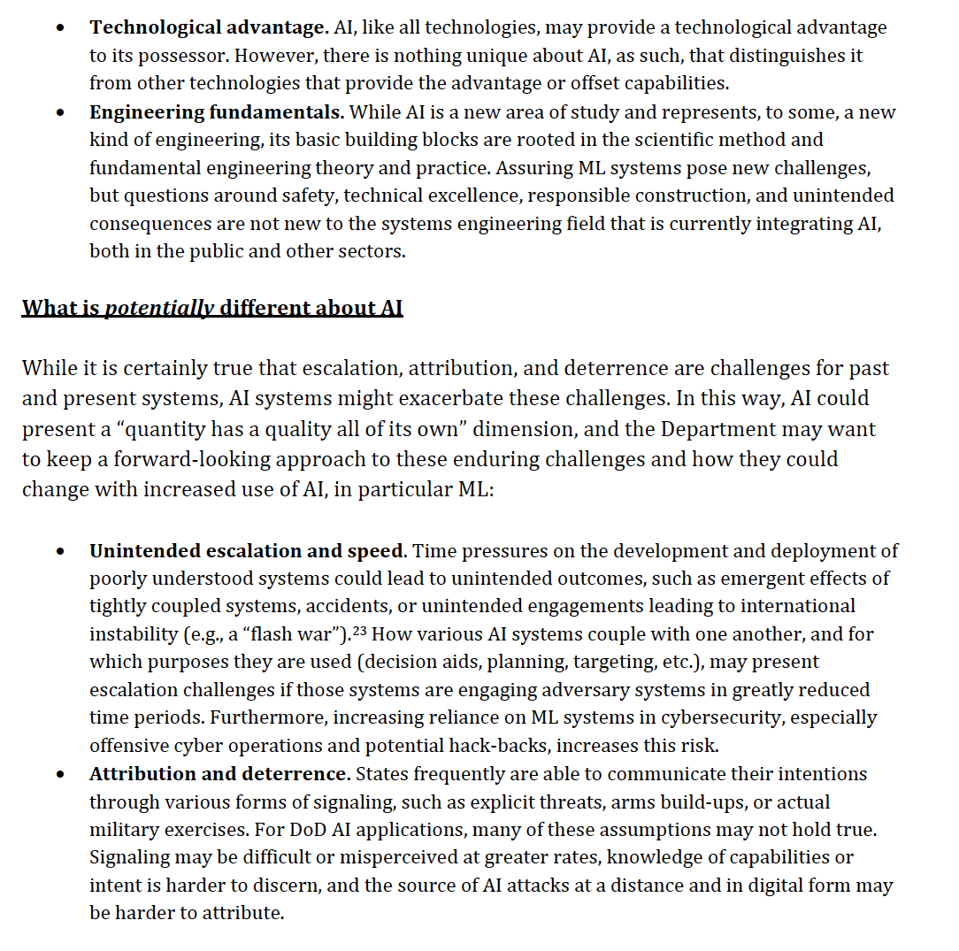
2019 Defense Innovation Board

Slide 39
2019 Defense Innovation Board

Slide 40
2019 Defense Innovation Board
What is different about AI
Augments or replaces human judgement
Safety challenges
Speed/scale/breadth of applications
Types of mistakes
Uncertainty regarding speed and direction of progress
Role of the private sector
Diffusion and access
Data and algorithmic bias

Slide 41
2019 Defense Innovation Board
Bias
Allerin.com

Slide 42
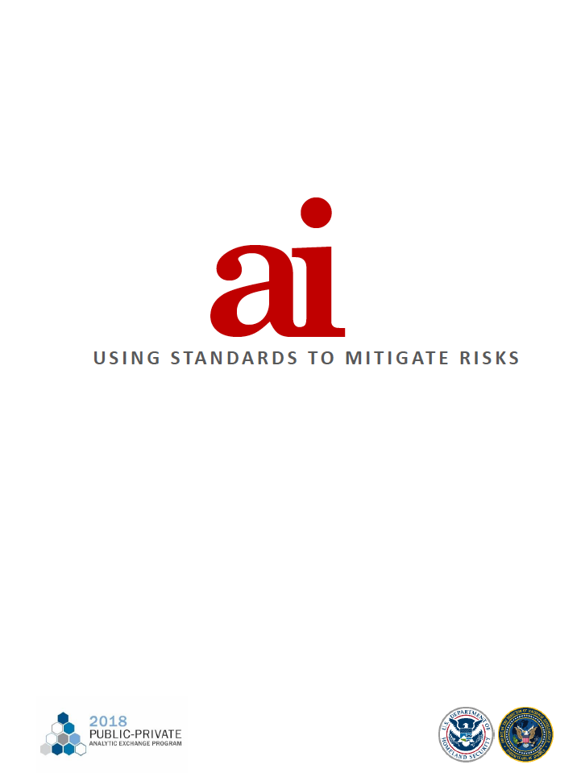
Overview
2019 Executive Order
2018 DoD AI Strategy
USAF Annex to DoD AI Strategy
2019 Defense Innovation Board Report
AI – Using Standards to Mitigate Risks
Senior DoD AI Personnel

Slide 43
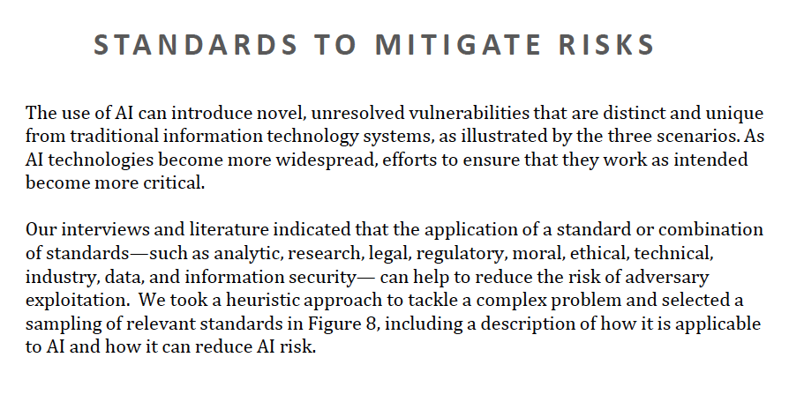
AI – Using Standards to Mitigate Risks

Slide 44
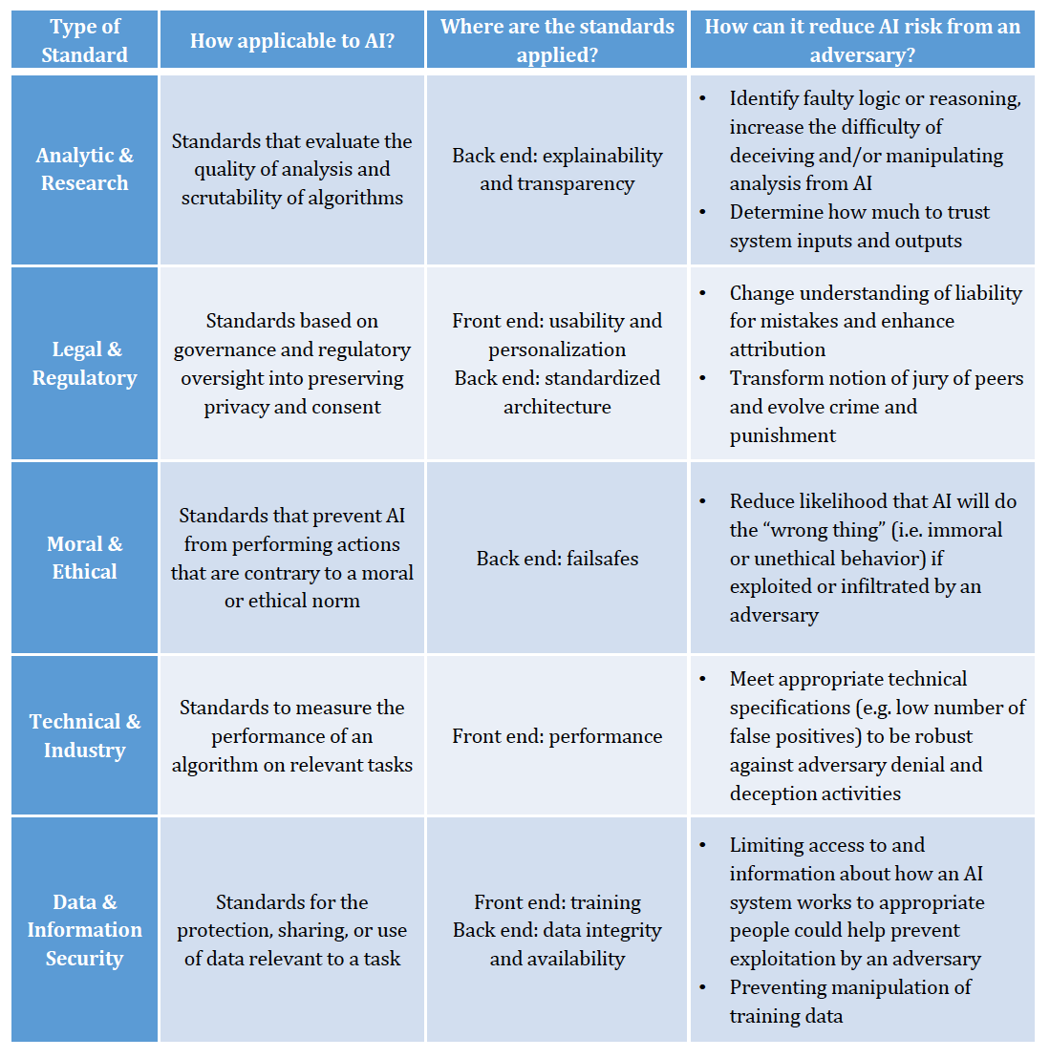
AI – Using Standards to Mitigate Risks

Slide 45
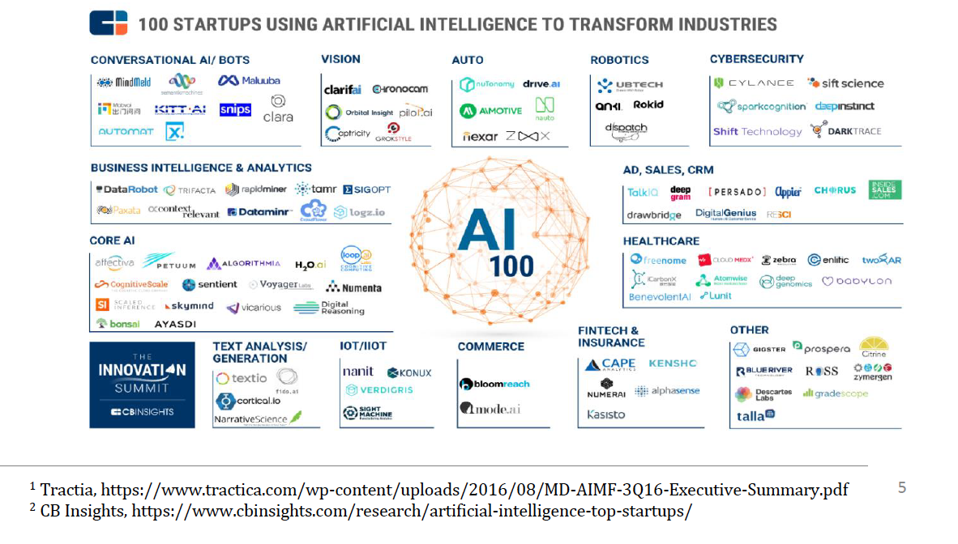
AI – Using Standards to Mitigate Risks

Slide 46
Overview
2019 Executive Order
2018 DoD AI Strategy
USAF Annex to DoD AI Strategy
2019 Defense Innovation Board Report
AI – Using Standards to Mitigate Risks
Senior DoD AI Personnel

Slide 47
Senior DoD Personnel
Director, Joint Artificial Intelligence Center (+ 200 people)
Dr. Nand Muchandadi
Principal Director of AI/ML USD(R&E) & Technical Director for Artificial Intelligence
Dr. Jill Crisman
Air Force CIO, CDO, AI Cross-Functional Team
AFRL Commander’s Autonomy Technical Advisor
Jean-Claude Lede joined in July 2018.
Army Research Laboratory, Army Senior Scientist (ST) for Intelligent Systems
Dr. Brian M. Sadler
Navy Chief AI Officer & AI Portfolio Manager for the Office of Naval Research
Mr. Brett Vaughan
DARPA Information Innovation Office
Dr. William Scherlis

